Slide 1
COVID-19 VACCINE ANALYSIS
PHASE-5

Slide 2
PROBLEM STATEMENT
The problem is to conduct an in-depth analysis of COVID-19 vaccine data, focusing on efficacy distribution and adverse effects. The goal is to provide insights that aid policymakers and health organizations in optimizing vaccine development strategies. This project involves data collection, data preprocessing, EDA , statistical analysis and visualization.

Slide 3
DESIGN THINKING
Data Collection
Data Preprocessing
Exploratory Data Analysis
Statistical Analysis
Visualization
Insights and Recommendations

Slide 4
DATA COLLECTION
On 1/1/2021 total vaccination count was 1000. people partially vaccinated is 800. In that 200 people are Fully vaccinated. On 1/2/2021 total vaccination count is 5000. people partially vaccinated is 4000. In that 1000 people are Fully vaccinated. On 1/3/2021 total vaccination count was 15000. people partially vaccinated is 12000.In that, 3000 people are Fully vaccinated. On 1/4/2021 total vaccination count was 30000. people partially vaccinated is 24000. In that, 6000 people are Fully vaccinated.

Slide 5
DATA SET
DATE | 1/1/2021 | 1/2/2021 | 1/3/2021 | 1/4/2021
TOTAL VACCINATIONS | 1000 | 5000 | 15000 | 30000
PARTIALLY VACCINATED | 800 | 4000 | 12000 | 24000
FULLY VACCINATED | 200 | 1000 | 3000 | 6000

Slide 6
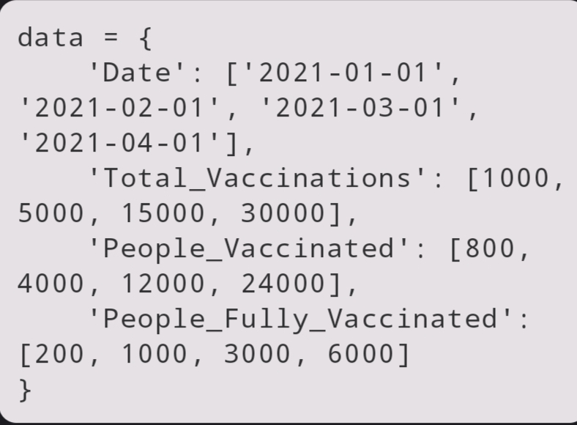
SAMPLE VACCINATION DATA
This code defines a sample dataset with columns for "Date," "Total_Vaccinations," "People_Vaccinated," and "People_Fully_Vaccinated." You would replace this with your actual dataset.

Slide 7
STATISTICAL ANALYSIS
Day by day vaccine count keeps increasing.
VACCINES COUNT IN PERCENTAGE:
1st Day: 1.9%
2nd Day: 9.8%
3rd Day: 29.4%
4th Day: 58.8%

Slide 8
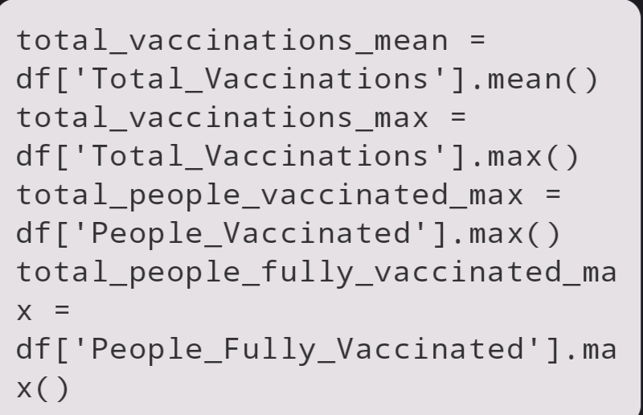
BASIC STATISTICS
Calculate basic statistics, including the mean and maximum values for various vaccination-related columns.

Slide 9
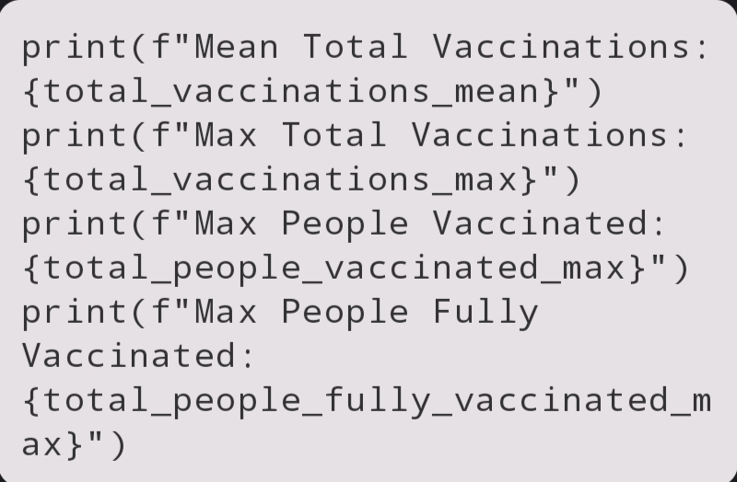
PRINT STATISTICS
Print the calculated statistics to the console.

Slide 10
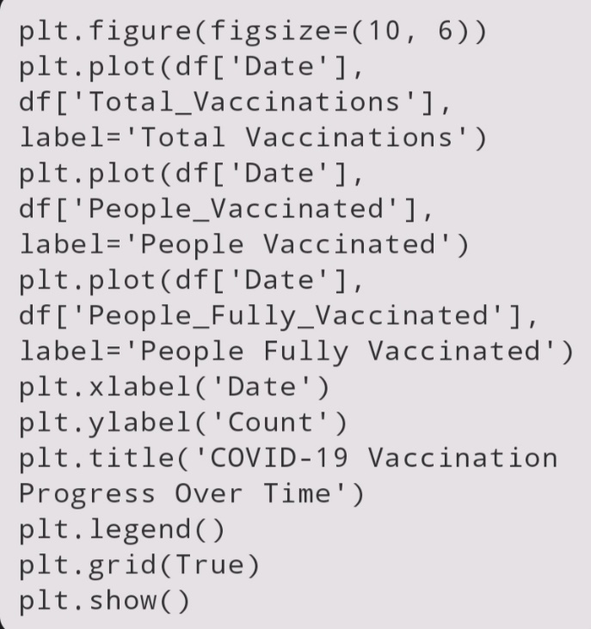
PLOT THE DATA
This code creates a line plot that visualizes the vaccination progress over time for different categories. It sets labels, titles, legends, and gridlines to make the plot informative.
Now, when you run this code, you'll get a plot showing the COVID-19 vaccination progress over time, along with basic statistics printed to the console.

Slide 11
VISUALIZATION

Slide 12
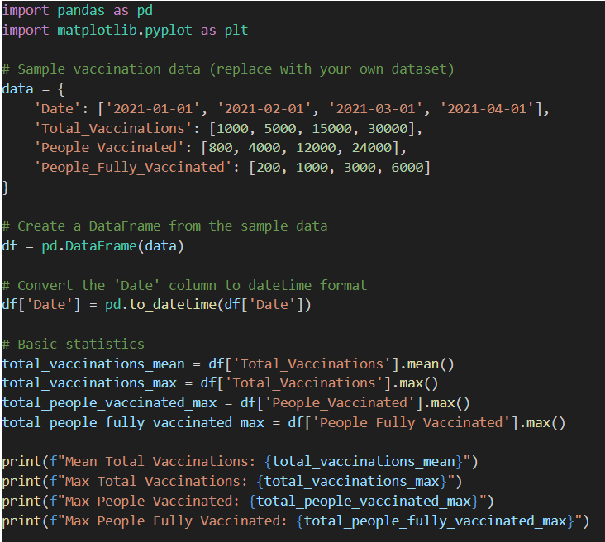
code

Slide 13
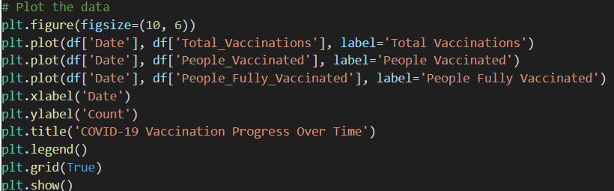

Slide 14
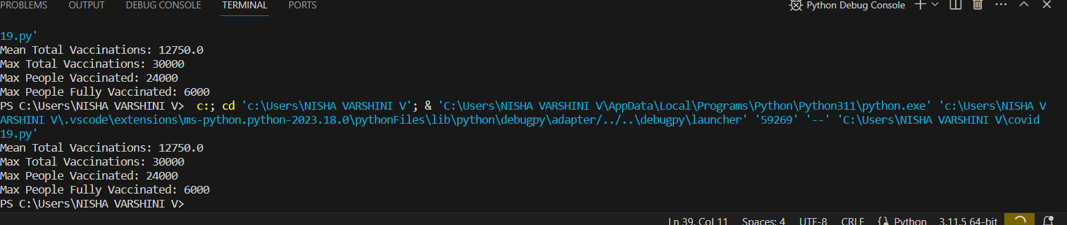
PRE PROCESSING

Slide 15
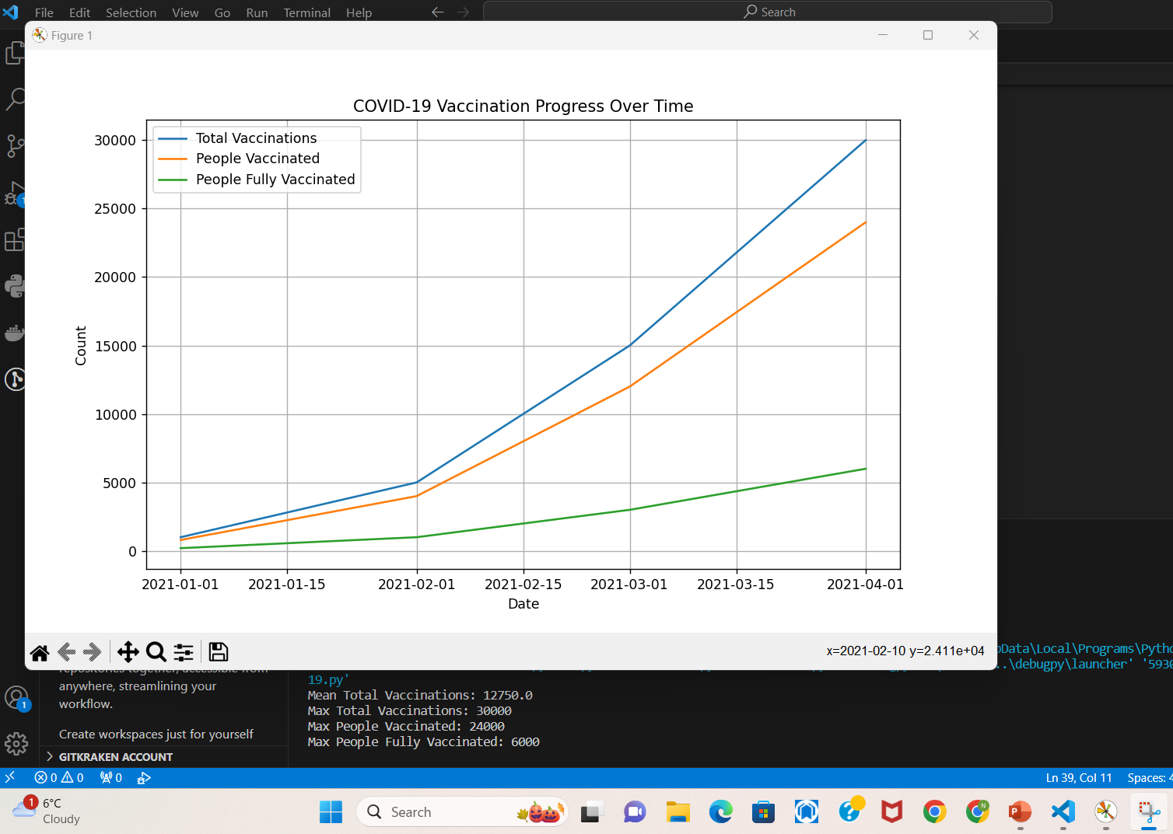
VACCINATION RESULT

Slide 16
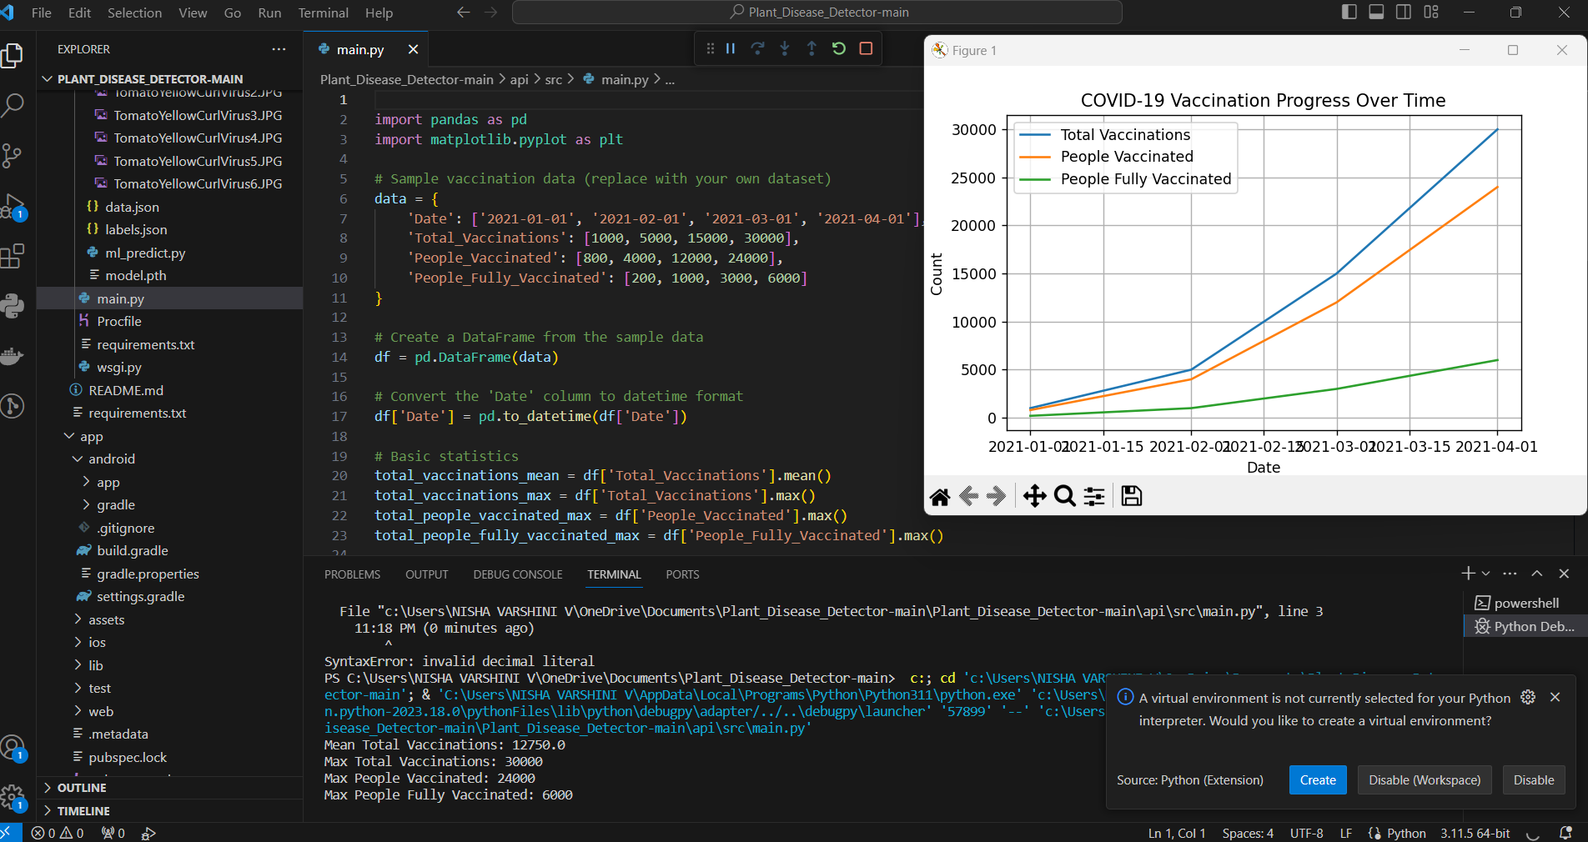
FINAL RESULT

Slide 17
CONCLUSION
In conclusion, this initial analysis provides a starting point for understanding the Covid-19 vaccine data. Further analyses and data-driven insights can be developed to optimize vaccine deployment strategies, better understand vaccine distribution patterns, and assess the impact of vaccination on public health outcomes. This analysis can serve as a foundation for more extensive research and as a valuable resource for policymakers and health organizations seeking data-driven guidance in their efforts to combat the COVID-19 pandemic.

